Slide 1

Parent Meeting
Phonics Screening Check

Slide 2

Reading changes everything
By the end of Year 1, we want all of our children to be able to read accurately and be able to read both familiar and unfamiliar words – this allows them to go on to become a fluent, enthusiastic reader.

Slide 3
What is the Phonics Screening Check?
The Phonics Screening Check is a statutory assessment for
Year 1 pupils in England, designed to evaluate their phonics skills.
To ensure that they have met the standard by the end of Y1.
The check will take place in June.

Slide 4
What is the Phonics Screening Involve?
A word-reading test at the end of Year 1.
Children read 40 words in total.
Children complete the phonics screening check at the end of Year 1 so that parents can be confident their children are being taught to read successfully. However as we know, each child is on their own reading journey.
Children read 40 words.
If they do not manage to read 32 of the words successfully, they continue RWI in year 2 and repeat the check at the end of the year.
It means that all children will be able to read accurately before they begin Year 3.

Slide 5
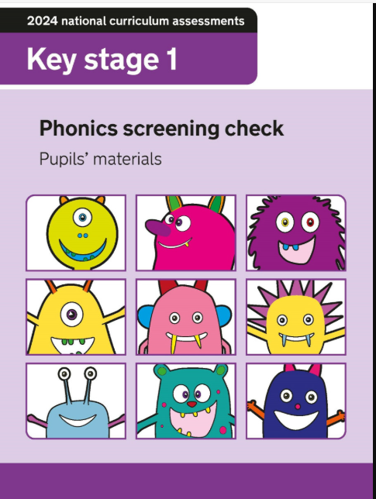
Here is an example of what the papers look like. There are also some examples at the front for you to look at.

Slide 6
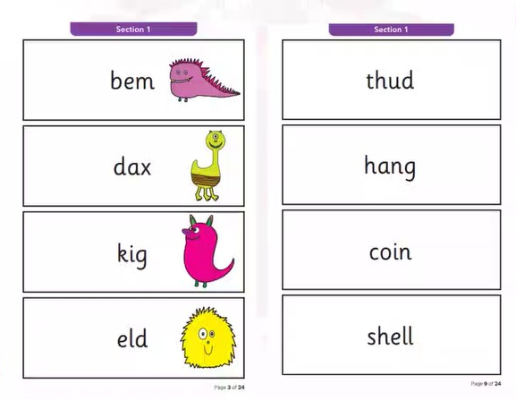
20 of the words in the check are real words and 20 are nonsense words.
There is a picture of an alien next to each word to remind the children that it isn’t a real word – this ensures that the children will rely on decoding the sounds and blending them in order to read the word, rather than attempting to sight read.

Slide 7
What we do at School
Children are have daily phonics lessons.
30 minute story book sessions which focusses on reading – giving them an opportunity to apply their sound knowledge in reading and build fluency as well as practise their reading comprehension skills.
20 minutes which is a speed sounds lesson- where a new sound is taught each day – then the children practise reading and spelling that sound in a range of words. The children also practise ‘alien words’.

Slide 8
Speed Sounds Set 3

Slide 9

‘Special Friends’, ‘Fred Talk’
We teach children to words using the routine ‘Special Friends’, ‘Fred Talk’, read the word’.
Notes:
Model special friends, fred talk, read the word.

Slide 10

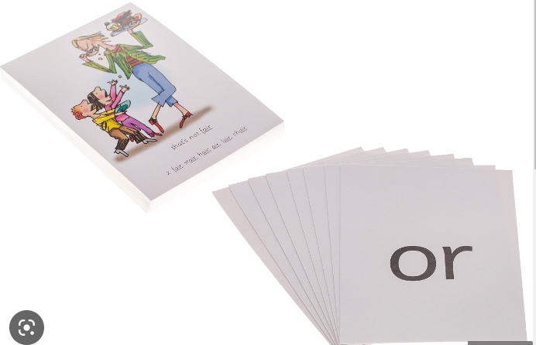
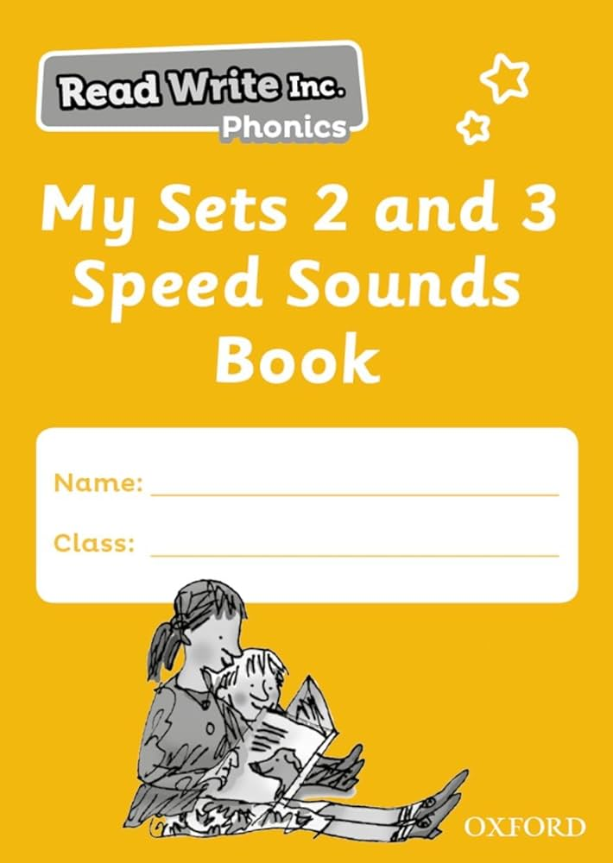




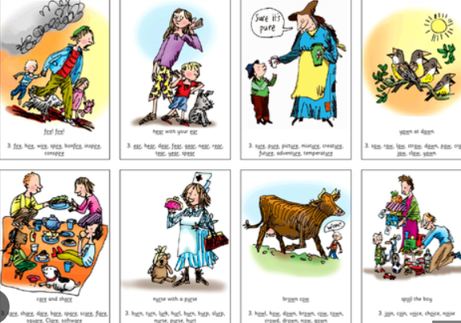
Things that you can do at home
If your child has a speed sounds workbook use this to support them in recognising their sounds. You can also:
Encourage them to read and write words with these sounds in.
Use flashcards and the sounds video links which are sent home.
Please ensure your child reads their book as much as possible over the weekend.
We will send a practise paper home with you today.

Slide 11
Things that you can do at home
Help your child to use ‘Special Friends’, ‘Fred Talk’ to read words.
Practise reading sounds speedily.
Watch the Virtual Classroom films together.
Listen to your child read.
Read to your child at home.

Slide 12
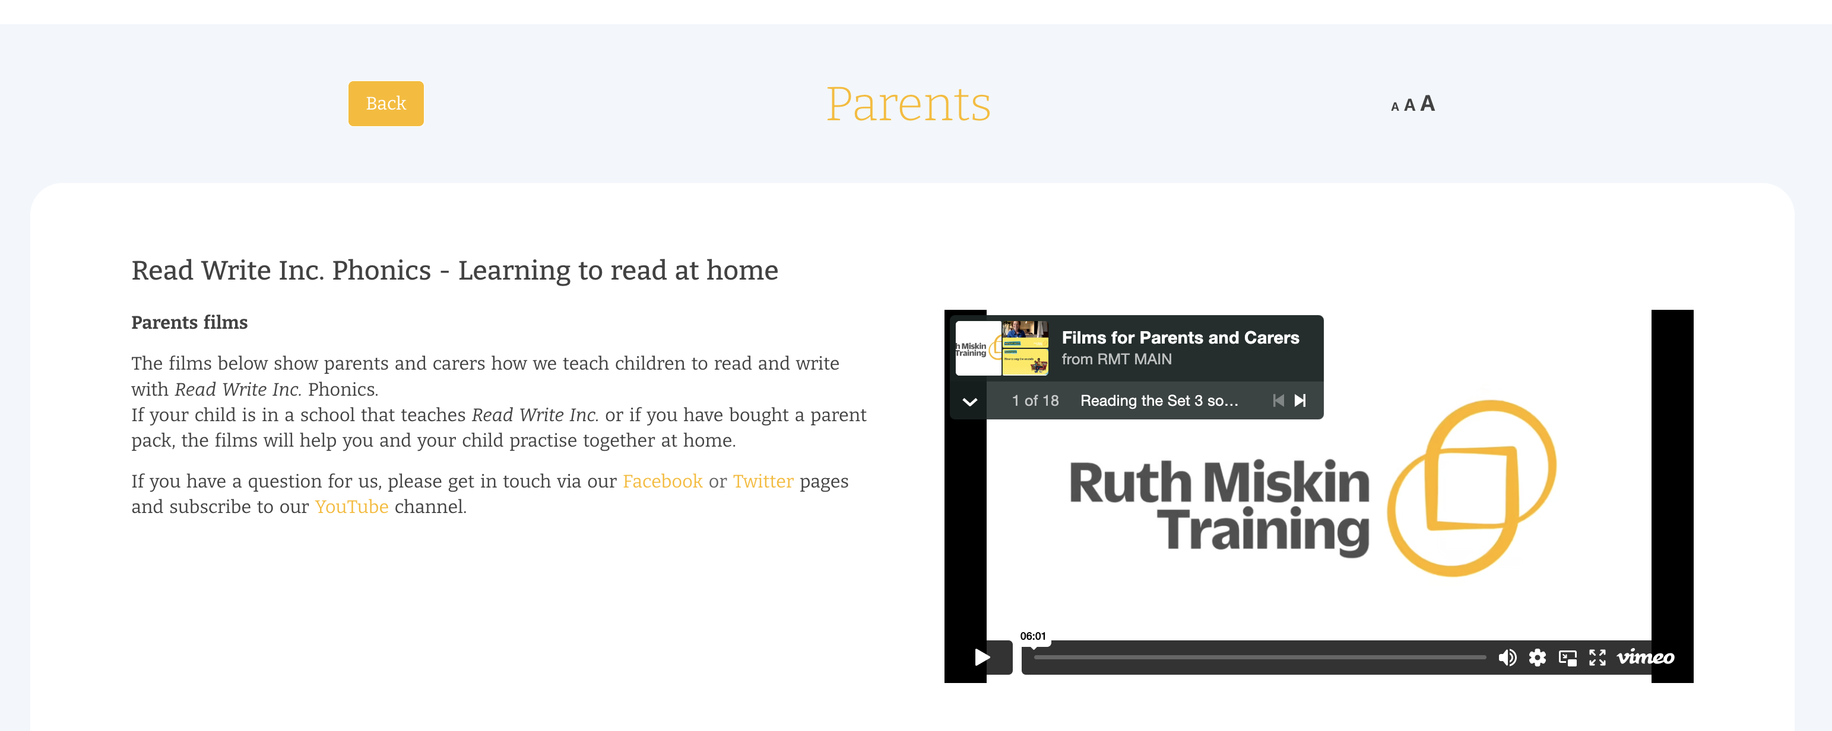
Free Video Tutorials (ruthmiskin.com)

Slide 13
Online resources available
Ruth Miskin Parents’ Page:
https://www.ruthmiskin.com/parents/
Ruth Miskin Facebook:
https://www.facebook.com/miskin.education
Free e-books for home reading:
http://www.oxfordowl.co.uk/Reading/

Slide 14

Any questions?

Slide 15
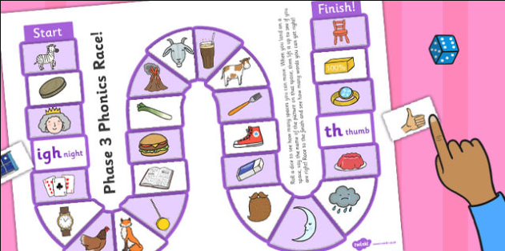
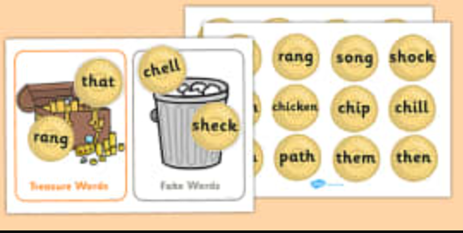

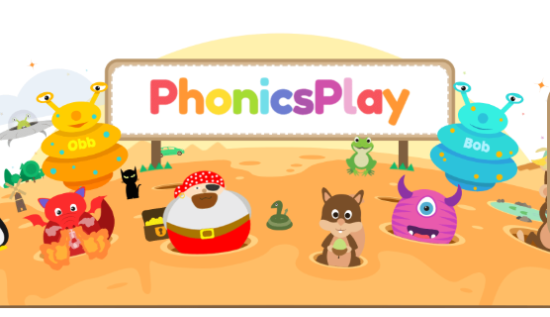
Today’s activities
Table 1 – Phonics board games
Table 2– Sorting activities.
Sorting ‘Alien’ and real words.
Table 3 – Phonics board games
Tablet activities – Phonics play
PhonicsPlay

Slide 16

Thank you for being
here today!

