Slide 1
Reading: What does it look like at Saint Joseph’s?

Slide 2
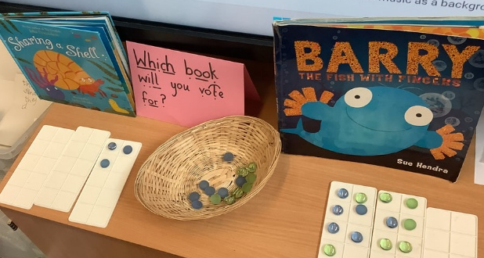


What does reading look like in the EYFS?
1. Phonics – Daily Read Write Inc phonics sessions build letter–sound knowledge and blending skills, with targeted groups and decodable books sent home to support fluency.
3. Reading for Pleasure – Children enjoy independent and peer reading in a cosy reading corner, with weekly library visits for borrowing books and story time to deepen engagement.
2. Story Time – Daily read-alouds enhance vocabulary and comprehension, with a daily book vote fostering choice and engagement.
4. Comprehension and Oracy – Children build comprehension through retelling and predicting, supported by Voice 21 oracy strategies that enhance confidence, vocabulary, and communication skills.
Combining systematic phonics with a language-rich, talk-focused environment, builds confident early readers.
Notes:
Phonics – Daily, structured sessions following Read Write Inc, focusing on secure letter–sound knowledge, blending, and segmenting skills. Children are regularly assessed and grouped to ensure targeted teaching. Carefully matched decodable books are sent home to reinforce learning and build reading fluency.
Story Time – Daily read-alouds enrich vocabulary and strengthen comprehension. Children take part in a daily book vote, promoting choice, engagement, and ownership of their reading experience.
Reading for Pleasure – Children are encouraged to explore books independently or with peers in a cosy, inviting reading corner. Weekly library visits allow children to choose books to take home and story time in the library further enhances the experience, making books exciting, meaningful, and memorable.
4. Comprehension and Oracy – Children develop understanding through retelling, predicting, and discussing stories. A strong focus on oracy supports language development, with Voice 21 strategies such as sentence stems, dialogic talk, and structured conversation scaffolding. This builds confidence, vocabulary, active listening, and expressive communication.

Slide 3

What does it look like in Year 1?
1. Phonics and Storybook Sessions: Daily Read Write Inc phonics lessons and storybook sessions build decoding skills, fluency, and comprehension.
3. Story Time and Library Visits: Daily story sessions to build vocabulary and enjoyment, plus weekly library visits for book borrowing and story time to encourage a love of reading.
4. Comprehension Development: At the start of Year 1, children complete transcription units, progressing later in the year to comprehension lessons that explicitly teach VIPERS skills—developing vocabulary, inference, prediction, explanation, retrieval, sequencing, and summarising.
2. Targeted Reading Practice: Daily reading for the lowest 20%, with twice-weekly or weekly reading for others, using their RWI matched texts to support progress.
Reading in Year 1 integrates daily phonics, structured reading support, targeted practice, and rich language experiences to cultivate confident, fluent readers.

Slide 4

What does it look like in Year 2?
1. Children who still require additional phonics support go out with Reception and Year 1 children for phonics (grouped accordingly).
2. Children who do not require phonics sessions take part in guided reading (again grouped accordingly) to mainly help develop their word reading fluency. This is important to support children in developing fluency before they enter KS2!
3. Whole class reading comprehension sessions will be introduced in Autumn 1 and they will be linked to the VIPERS reading skills. This will be once a week in an English lesson. All children will be in this lesson!
4. Daily readers (Lowest 20%) will be heard all year round.
Children will visit the library once a week to take a reading for pleasure book home alongside their banded book.
They will also visit once a week for story time ☺
Storytime every day.

Slide 5
What does it look like in KS2?
1. Children who failed the phonics re-test in Year 2 are to continue to have phonics intervention .
2. All children will take part in whole class daily reading sessions 3 x a week (30/35mins per session). These are to focus heavily on the modelling and teaching of reading fluency! They will also explicitly teach the VIPERS reading skills.
3. Daily readers (Lowest 20%) will be heard all year round.
Children will visit the library once a week to take a reading for pleasure book home alongside their banded book. They are to have an opportunity to sit and use the library as a calming reading space. It is valued by the children!
Storytime every day at least 3 x a week
Children will remain on banded books in Year 3 and Children who are Expected/Greater depth in reading to become free readers in Autumn 2.

