Slide 1

Parent Meeting
Phonics Screening Check
The important notes are added in yellow.

Slide 2
Reading changes everything
Teach a child to read and keep that child reading and we will change everything.
And I mean everything.
Jeanette Winterson
By the end of Year 1, we want all of our children to be able to read accurately and be able to read both familiar and unfamiliar words – this allows them to go on to become a fluent, enthusiastic reader. The Phonics Screening Check in June is a word reading test to check children can read sounds in words accurately.
Accurate word reading at 6 is a predictor of future success.

Slide 3
Do not edit
How to change the design
When do you need the skills to read?
The Slido app must be installed on every computer you’re presenting from

Slide 4
What is the Phonics Screening Check?
A word-reading test at the end of Year 1.
Children read 40 words.
Children complete the phonics screening check at the end of Year 1 so that parents can be confident their children are being taught to read successfully.
Children read 40 words. It takes between two and five minutes.
If they do not manage to read 32 of the words successfully, they continue RWI in year 2 and repeat the check at the end of the year.
It means that all children will be able to read accurately before they begin Year 3.

Slide 5
Speed Sounds Set 3

Slide 6

‘Special Friends’, ‘Fred Talk’
We teach children to words using the routine ‘Special Friends’, ‘Fred Talk’, read the word’.
Notes:
Model special friends, fred talk, read the word.

Slide 7




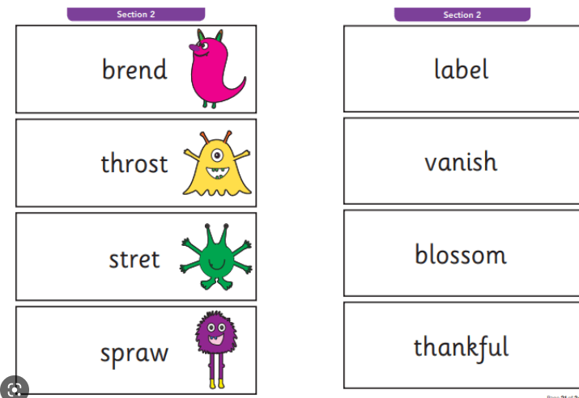
Nonsense words
Half of the words in the check are real words.
Half are nonsense words. For example, ‘sheb’, ‘glight’, ‘ched’, ‘teb’.
There is a picture of an alien next to each word to remind the children that it isn’t a real word.
This is what the paper will look like.

Slide 8
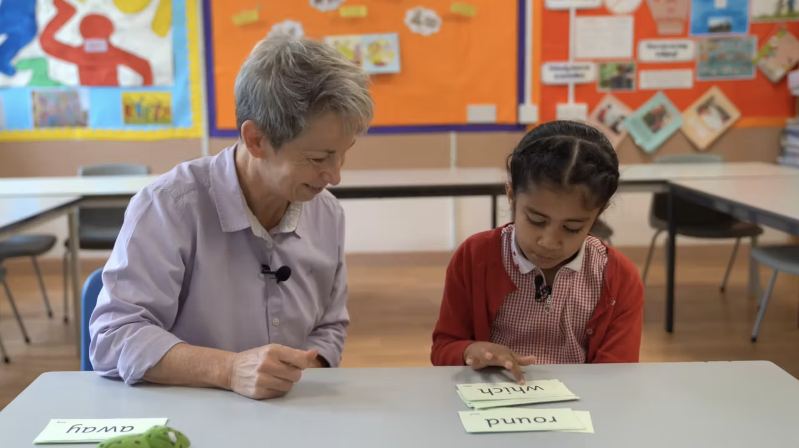
Teach every child to read

Slide 9
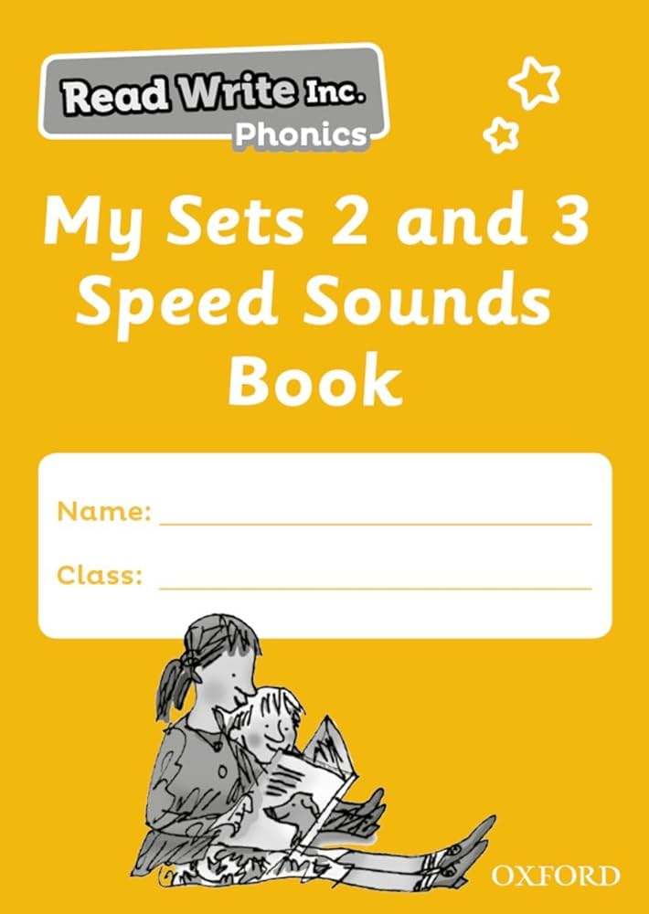







Practice at home
If your child has a speed sounds workbook use this to support them in recognising their sounds.
Encourage them to read and write words with these sounds in. Use flashcards and the sounds video links which are sent home. Please ensure your child reads their book as much as possible over the weekend.

Slide 10
What can I do?
Help your child to use ‘Special Friends’, ‘Fred Talk’ to read words.
Practise reading sounds speedily.
Watch the Virtual Classroom films together.
Listen to your child read.
Read to your child at home.

Slide 12
Do not edit
How to change the design
What is the primary purpose of the Phonics Screening Check?
The Slido app must be installed on every computer you’re presenting from

Slide 13
Do not edit
How to change the design
How many words are included in the Phonics Screening Check?
The Slido app must be installed on every computer you’re presenting from

Slide 14
Do not edit
How to change the design
What type of words are used in the Phonics Screening Check?
The Slido app must be installed on every computer you’re presenting from

Slide 15
Do not edit
How to change the design
When is the Phonics Screening Check typically administered?
The Slido app must be installed on every computer you’re presenting from

Slide 16
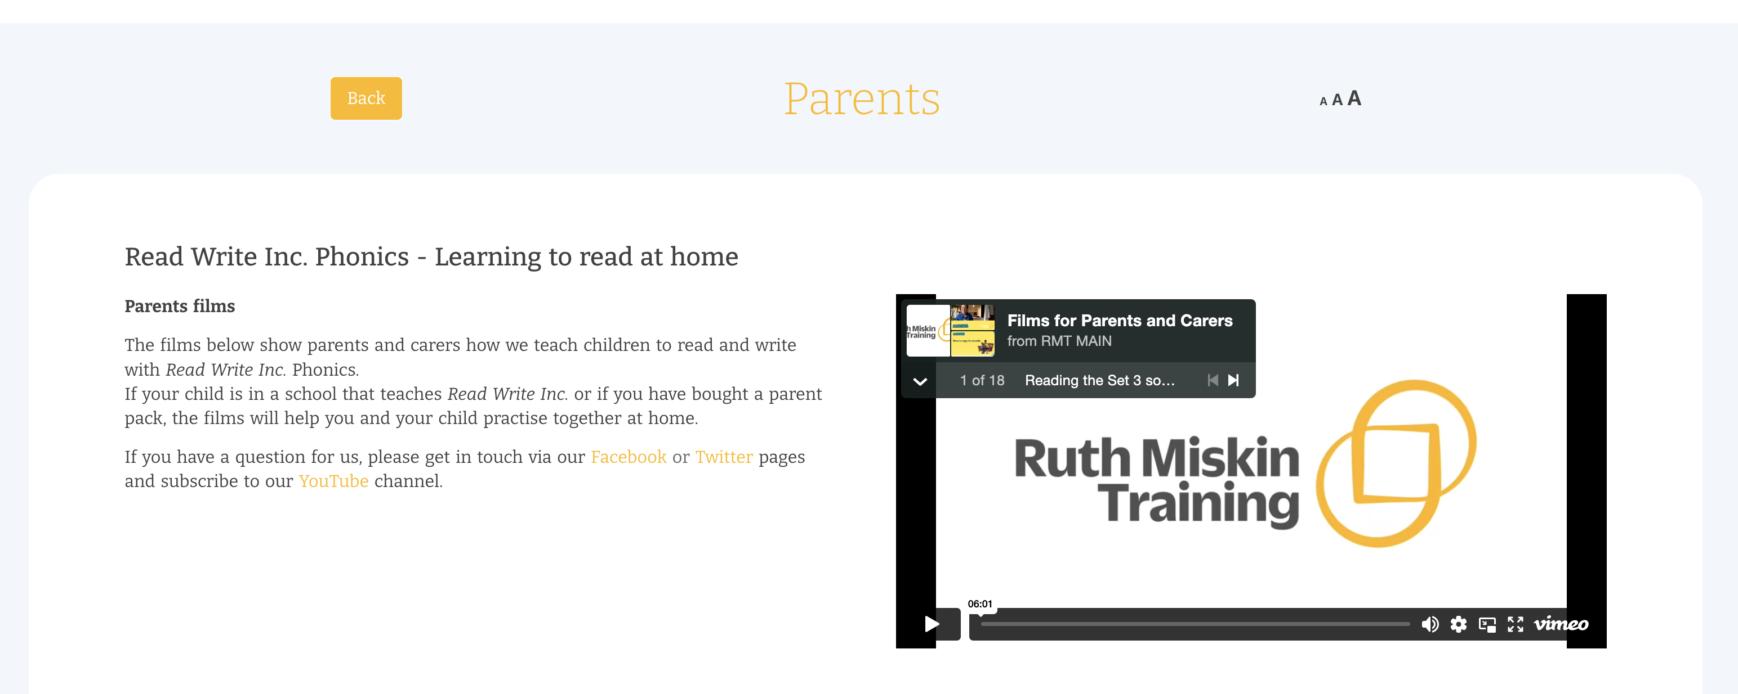
Free Video Tutorials (ruthmiskin.com)

Slide 17
Online resources available
Ruth Miskin Parents’ Page:
https://www.ruthmiskin.com/parents/
Ruth Miskin Facebook:
https://www.facebook.com/miskin.education
Free e-books for home reading:
http://www.oxfordowl.co.uk/Reading/

Slide 18

Any questions?

