Slide 1
Welcome to the Year 2 Parent Workshop

Slide 2
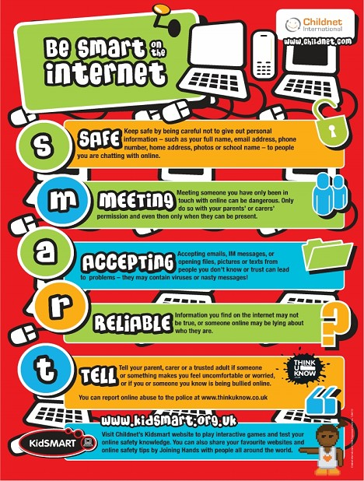
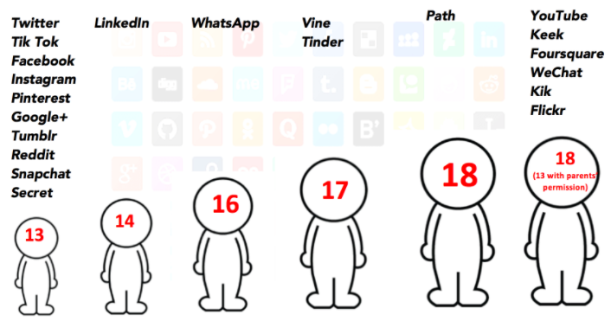
Online Safety

Slide 3
St Joseph's School Rules
Following in Jesus' Footsteps, caring for each other when we work, play and pray
Use Kind Words and Hands
Show Perfect Presentation
Be the Best Person
Jesus Wants Us to Be
“Be kind and compassionate to one another, forgiving each other, just as in Christ God Forgave you.“ Ephesians 4:32
“Therefore, encourage one another and build up one another up, just as you are doing. ” Thessalonians 5:11
“Commit your work to the Lord and your plans will succeed.” Proverbs 16:3
Display Good Manners
Respect Each Other/ Environment
Listen to One Another
“And as you wish that others would do to you, do so to them.” Luke 6:31
“A new command I give you: Love one another. As I have loved you, so you must love one another.” John 13:34
“To speak evil of no one, to avoid quarrelling, to be gentle and to show perfect courtesy to all people.” Titus 3:2

Slide 4
We celebrate the children’s academic and behavioural achievements
House points
Certificates
Carpenters coins
Class trophies
Verbal Praise
Class Dojo Points

Slide 5
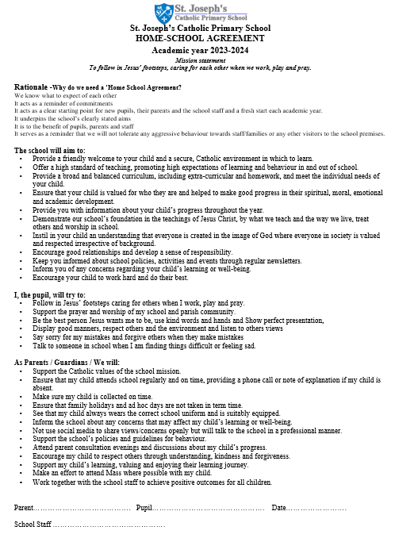
Home school Agreement
The home school agreement will be sent out via parent mail and receiving it will be your 'signature'.

Slide 6
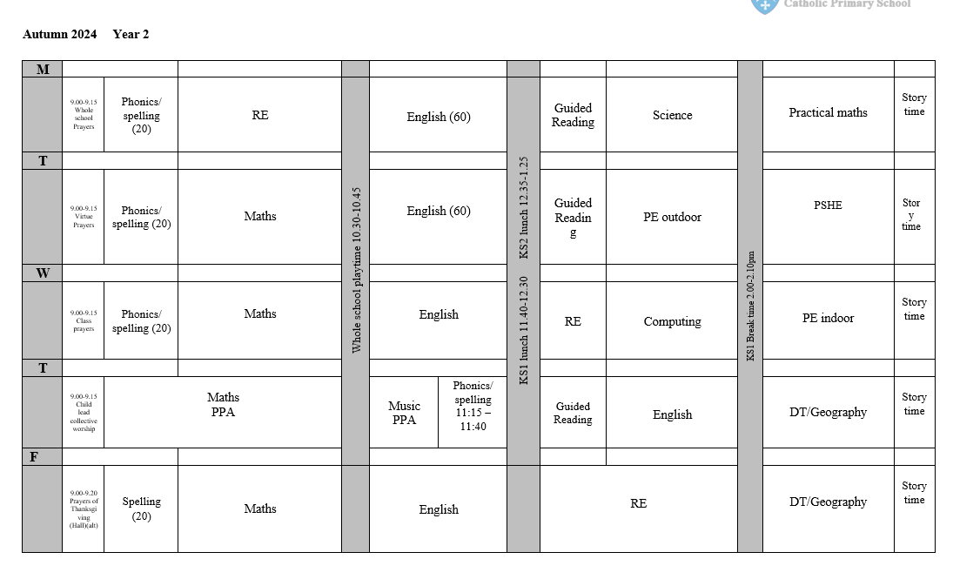
Typical Day 2024-2025

Slide 7
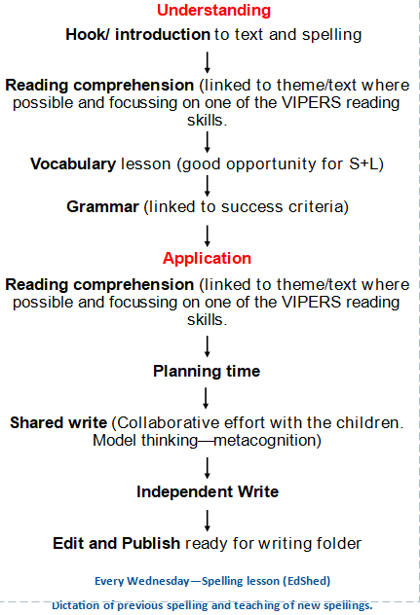
English - The writing process

Slide 8
Spellings
Spellings are taught everyday with a new spelling rule introduced every Wednesday. Children then apply these spellings in a range of activities across the week.
For children who are continuing with RWI, spellings will be given out every Thursday and tested on the following Friday.

Slide 9
Year 2 English texts

Slide 10
Reading
In school, we do whole class reading. This allows the class to explore age appropriate texts together.
The children are exposed to vocabulary and the children have an opportunity to explore different fiction, non-fiction and poetry books.
The children will then answer questions based on the pages that they have read that day or other tasks depending on the focus for the lesson.
At the end of the day we read to the children for 15 minutes before they go home.

Slide 11
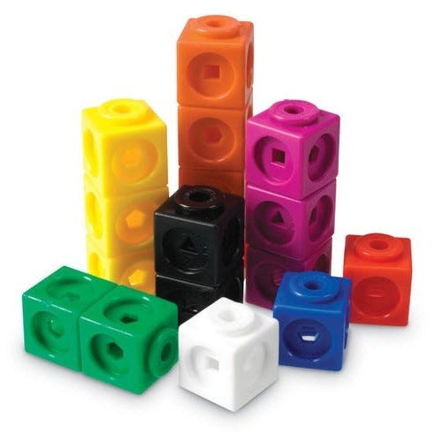
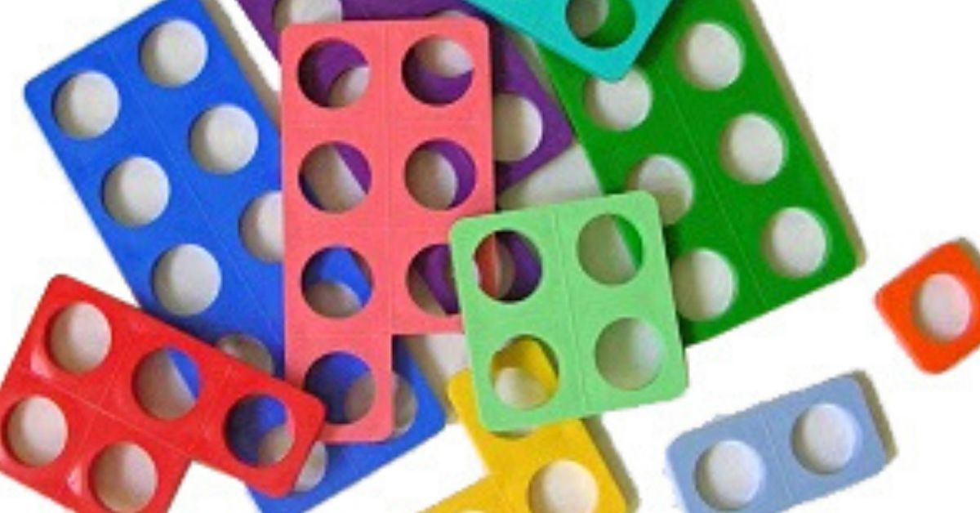
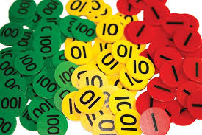
Mathematics
Mathematics is taught every day.
We place emphasis on being fluent in the topic being taught and then move onto reasoning and problem solving – applying that knowledge.
As a school, we a following the CPA approach: concrete, pictorial and abstract.

Slide 12
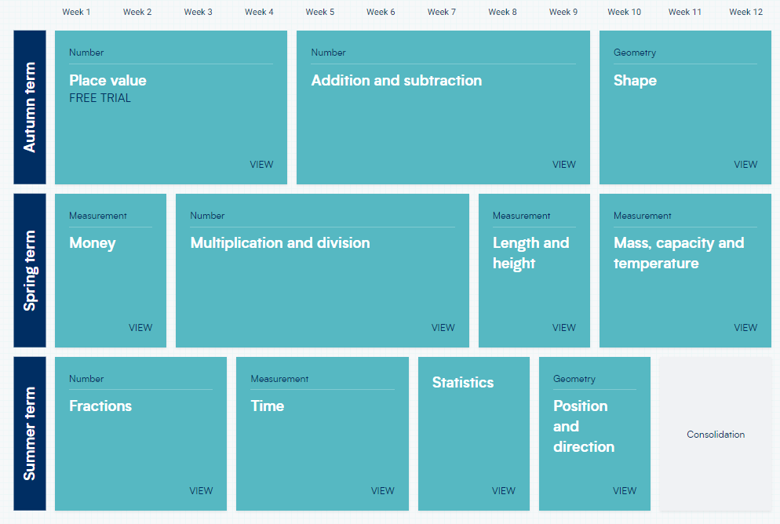
White Rose maths scheme

Slide 13
Mathematics
In year 2 we like to begin the lesson by briefly re-capping previous learning or setting some questions based on core understanding. We call this a flashback 4.

Slide 14
PE
Our PE uniform is as follows:
Plain royal blue t-shirt
Plain black shorts
Indoor black pumps
PE socks
Plain black / blue (without logo) tracksuit
Children should keep their PE kits in school until the end of the half term. P.E will take place on a Tuesday and a Wednesday this term.

Slide 15
Home Reading and Homework
Home Reading
Your child has a reading diary and reading book from school. Please read the book with your child and ask them questions about the text when you sit together. Please write a comment in your child’s reading record each week to let us know how they have got on.
New books will be given out every Thursday. We ask that children keep the book they are reading in their bags so that we can read with the children in school as well. Please ensure that the books are back in school by the following Wednesday ready to be changed.
Although we encourage children to read their reading book from school at home, they can also read other books at home too!
Homework
Spelling homework is available on ED shed, with new spelling rules added on Thursdays. We encourage children to practise daily for 10-15 minutes or whenever possible.
Maths homework is to continue using Numbots to practise key skills.

Slide 16
How you can help at home
Encourage your child to learn and practise their spellings to improve their writing.
Encourage your child to access their homework at home.
Instil a love of reading!
Reading books will be sent home on Thursdays, please return your child’s book on Mondays, so it can be changed.

Slide 17
If you ever have any questions or concerns please come and speak to us!

Slide 18
Thank you for joining us today!

