Slide 1
Welcome to the Year 5 Parent Workshop
Fire alarm & Exits

Slide 2
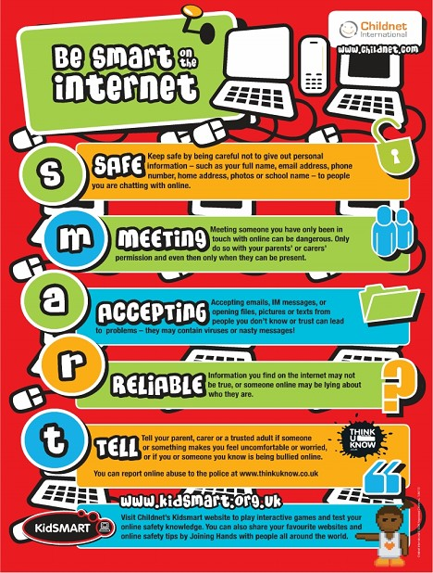
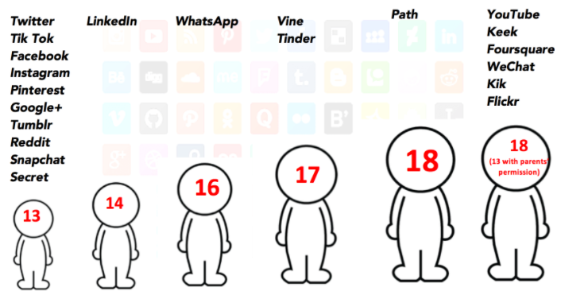
Online Safety

Slide 3
St Joseph's School Rules
Following in Jesus' Footsteps, caring for each other when we work, play and pray
Use Kind Words and Hands
Show Perfect Presentation
Be the Best Person
Jesus Wants Us to Be
“Be kind and compassionate to one another, forgiving each other, just as in Christ God Forgave you.“ Ephesians 4:32
“Therefore, encourage one another and build up one another up, just as you are doing. ” Thessalonians 5:11
“Commit your work to the Lord and your plans will succeed.” Proverbs 16:3
Display Good Manners
Respect Each Other/ Environment
Listen to One Another
“And as you wish that others would do to you, do so to them.” Luke 6:31
“A new command I give you: Love one another. As I have loved you, so you must love one another.” John 13:34
“To speak evil of no one, to avoid quarrelling, to be gentle and to show perfect courtesy to all people.” Titus 3:2

Slide 4
We celebrate the children’s academic and behavioural achievements
House points
Certificates
Carpenters coins
Class trophies
Verbal Praise
Raffle tickets

Slide 5
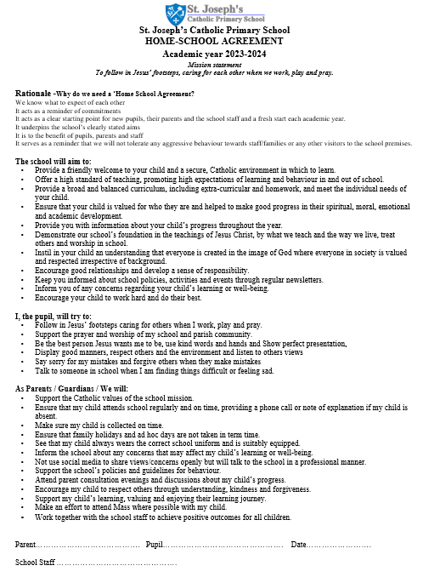
Home school Agreement
The home school agreement will be sent out via parent mail and receiving it will be your 'signature'.

Slide 6
Attendance

Slide 7
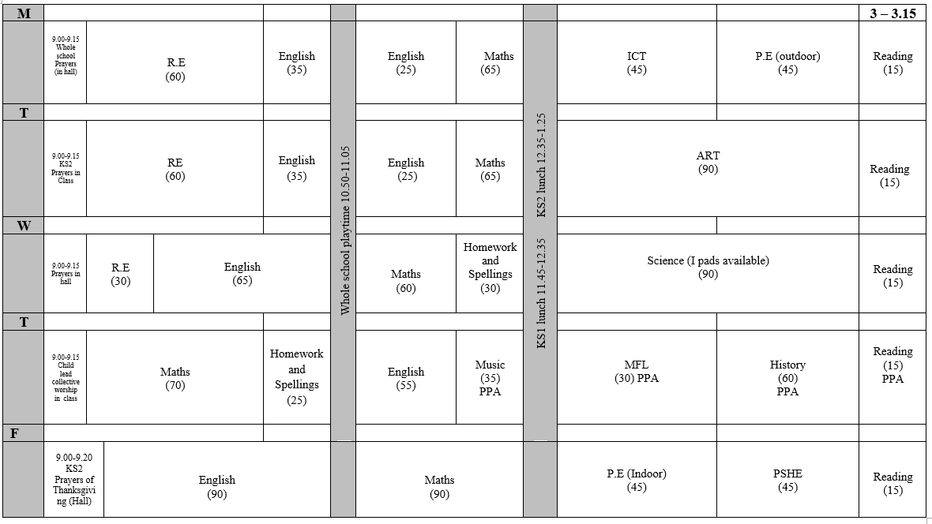
Typical Day 2023- 2024

Slide 8
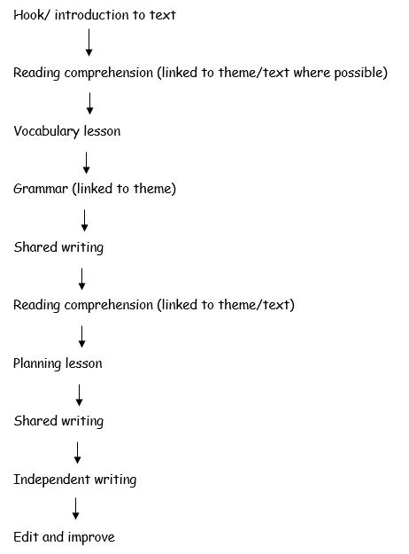
English - The writing process

Slide 9
Spellings
Spelling is taught every Wednesday. Spellings are given out every Thursday (with homework) to aid children for the following lesson. Children then apply these spellings in a range of activities in their next spelling lesson to help with their application, comprehension and correct spelling.

Slide 10
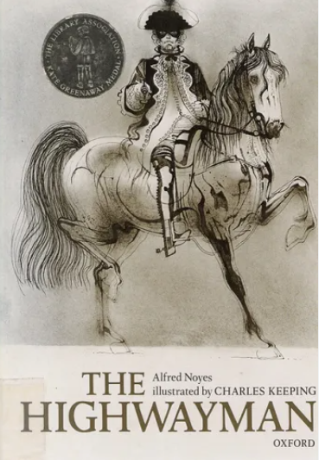
Year 5 English texts

Slide 11
Reading
In school, we do whole class reading. This allows the class to explore age appropriate texts together.
The children are exposed to vocabulary and the children have an opportunity to explore different fiction, non-fiction and poetry books.
The children will then answer questions based on the pages that they have read that day or other tasks depending on the focus for the lesson.
At the end of the day we read to the children for 15 minutes before they go home.

Slide 12
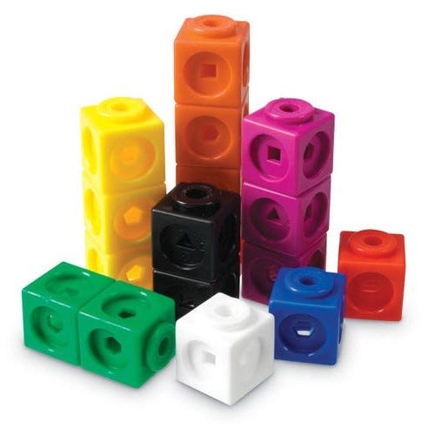
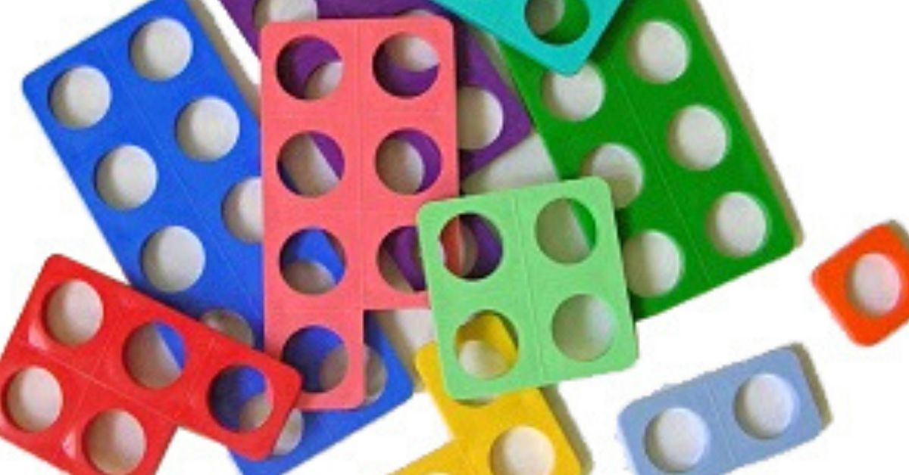
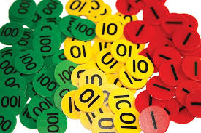
Mathematics
Mathematics is taught every day.
We place emphasis on being fluent in the topic being taught and then move onto reasoning and problem solving – applying that knowledge.
As a school, we a following the CPA approach: concrete, pictorial and abstract.

Slide 13
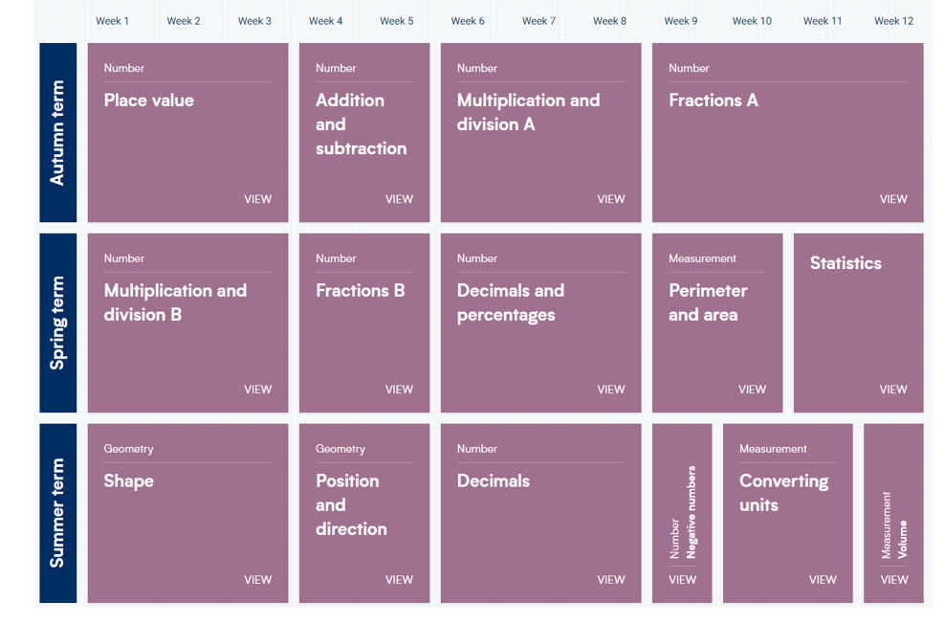
White Rose maths scheme

Slide 14
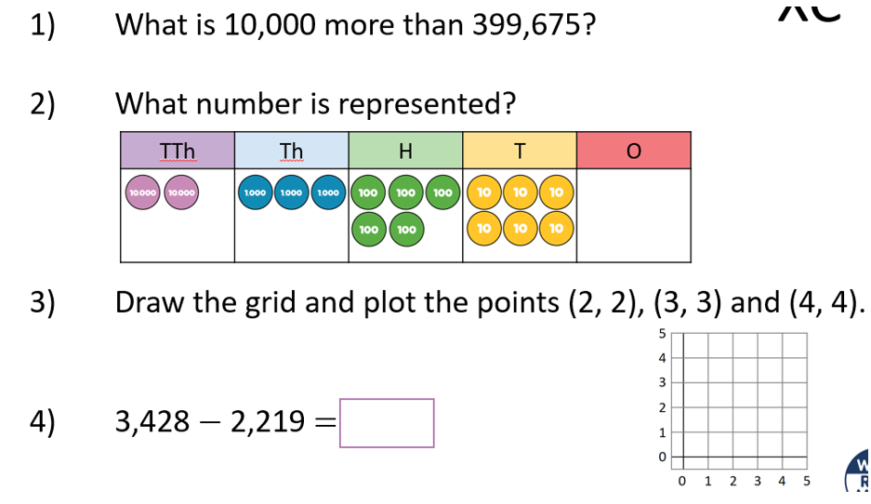
Mathematics
In year 5 we like to begin the lesson by briefly re-capping previous learning or setting some questions based on core understanding. We call this a flashback 4.

Slide 15
Mathematics
Children should be encouraged to play on TTRS to improve their fluency with their Times Tables.

Slide 16
PE
Our PE uniform is as follows:
Plain royal blue t-shirt
Plain black shorts
Indoor black pumps
PE socks
Plain black / blue (without logo) tracksuit
Children should keep their PE kits in school until the end of the half term. P.E will take place on a Monday and a Friday this term.

Slide 17
Home Reading and Homework
Home Reading
Your child has a reading diary and reading book from school. Please read the book with your child and ask them questions about the text when you sit together.
When children have finished their books and there is comment from an adult to say they have finished it, children should put their books into the box in the classroom to have their book changed. We ask that children keep the book they are reading in their bags so that we can read with the children in school as well.
Although we encourage children to read their reading book from school at home, they can also read other books at home too!
Homework
Homework will be set on a Thursday and will be due in the following Wednesday. (1 piece of maths, 1 piece of English and spellings).
Please speak to your child’s class teacher if there is an issue in completing the homework to the set dates.

Slide 18
How you can help at home
Times tables practise – TTRS!
Encourage your child to learn and practise their spellings to improve their writing.
Encourage your child to complete their homework at home.
Instil a love of reading!
Reading books need to come in on Wednesday in order to be changed by Friday. Please remind children to put their books in the box if they have finished it.

Slide 19
If you ever have any questions or concerns please come and speak to us!

Slide 20
Thank you for joining us today!

