Slide 1
Parents’ Meeting
Introduction to Read Write Inc.
Notes:
Approximately 20 minutes is needed for this session.
Notes are provided to help you lead the presentation.
Notes in italics are for your attention only.
This bitesize parent session is designed as an introduction to Read Write Inc when you first implement the programme in your school and for parents of new YR children each September.
Use the other bitesize parent PPTs throughout the year to discuss and practise how they can help their child at home based on the child’s group.
Notes are provided to help you lead the presentation.
Notes in italics are for your attention only.
Provide copies of ‘Reading at Home Booklet 1 or 2’ from Oxford Owl.
Booklet 1 is sound groups and Ditty/ Red Groups and Booklet 2 for Green – Grey Storybooks.

Slide 2
Read Write Inc. Phonics – Who is it for?
Children learning to read in YR– Y2
Older children who need to ‘catch up’
Taught in groups based on their stage of reading
Each half-term, we assess and group our children based on their stage of reading not age of reading. This means all children practise reading at the right level.
Notes:
Who Is Read Write Inc Phonics for?
(Click) Phonics is for children in Reception, Y1 and Y2 who are learning to read.
Phonics is also for children in Y3 and Y4 who haven’t met the KS1 reading expectations. They need to catch up.
(Click) Fresh Start is for children in Y5 and Y6 who are still learning to read.
Fresh Start is structured in the same way as the Phonics programme, but uses age-appropriate texts.
Each half-term, we assess and group our children based on their stage of reading not age of reading. This means all children practise reading at the right level.
Explain how you group across YR/ across KS1, across Y3/4 as applicable to your school.

Slide 3
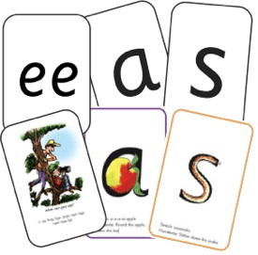



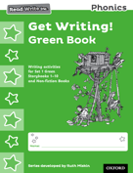

Read Write Inc. Phonics daily lessons
We teach sounds
Children practise reading and spelling words containing these sounds, then we give children decodable books (click) containing sounds and words they can read.
They read each Storybook three times at school and again with you at home.
On each reading, children’s fluency increases and the more they can focus on what the story is about.
Children also learn to spell the words they have been reading and develop their ideas into sentences so that they can write about the Storybooks they read.
Notes:
What Read Write Inc. does is simple - we teach sounds (click), children practise reading and spelling words containing these sounds (click), then we give children decodable books (click) containing sounds and words they can read.
They read each Storybook three times at school and again with you at home.
On each reading, children’s fluency increases and the more they can focus on what the story is about.
Children also learn to spell the words they have been reading and develop their ideas into sentences so that they can write about the Storybooks they read.
Alongside this we read stories to children: (click) stories they cannot yet read for themselves
Our aim is for children to finish the RWI Phonics programme quickly so they can start reading these books for themselves.

Slide 4
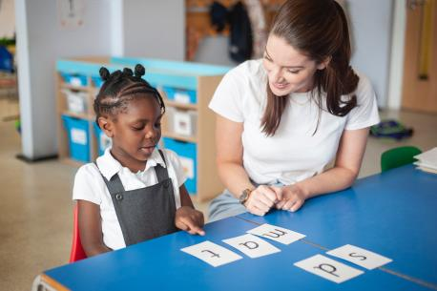
One-to-one tutoring – ‘keep up, not catch up!’
We want to make sure every child learns to read in our school.
Some children need extra practice when learning to read so we teach these children one-to-one for ten minutes every day – on top of their group lesson.
We make sure they ‘keep up’ from the beginning and don’t need ‘catch up’ later on.
Notes:
We want to make sure every child learns to read in our school.
Some children need extra practice when learning to read so we teach these children one-to-one for ten minutes every day – on top of their group lesson.
We make sure they ‘keep up’ from the beginning and don’t need ‘catch up’ later on.

Slide 5
What is phonics?
Sounds - All words are made up of individual sounds. These sounds are merged together to form words.
e.g. in ‘mat’ we have the sounds ‘m’, ‘a’, ‘t’, ship – ‘sh’, ‘i’, ‘p’.
Graphemes - A grapheme is another name for the letters we use to write the sound. The spelling of that sound on the page.
Phonics is the method of teaching reading through the identification of sounds and graphemes.
This gives your children the tools to read any word.
Notes:
All words are made up of individual sounds. These sounds are merged together to form words.
e.g. in ‘mat’ we have the sounds ‘m’, ‘a’, ‘t’, ship – ‘sh’, ‘i’, ‘p’.
Click A grapheme is another name for the letters we use to write the sound. The spelling of that sound on the page.
Phonics is the method of teaching reading through the identification of sounds and graphemes.
The new National Curriculum ensures that all children are taught Phonics systematically.
This gives your children the tools to read any word.

Slide 6
English alphabetic code
We use 44 sounds to make all the words in the English language. This means we’ve got a problem.
We’ve got 44 sounds and only 26 letters.
The 26 letters work singly, in pairs and sometimes in threes to represent one sound. We must group letters together to write some sounds e.g. ‘igh’, ‘air’.
In English we have more than 150 ways to represent 44 sounds, using the 26 letters in the alphabet.
One of the most complex alphabetic codes in the world.
Notes:
We use 44 sounds to make all the words in the English language.
This means we’ve got a problem.
We’ve got 44 sounds and only 26 letters.
The 26 letters work singly, in pairs and sometimes in threes to represent one sound.
We have to group letters together to write some sounds e.g. ‘igh’, ‘air’.
In English we have more than 150 ways to represent 44 sounds, using the 26 letters in the alphabet.
Click
This makes our language one of the most complex in the world!

Slide 7
Speed Sounds Set 1 and Set 2
Using RWI, we make learning to read easy for children because we start by teaching them just one way of reading and writing every sound. Here they are on the Simple Speed Sounds chart we use in class.
We teach Set 1 sounds first - (the grey parts).
Children need to know sounds – not letter names – to read words.
Notes:
Using RWI, we make learning to read easy for children because we start by teaching them just one way of reading and writing every sound. Here they are on the Simple Speed Sounds chart we use in class.
We teach Set 1 sounds first - (sounds as far as a e i o u).
Children need to know sounds – not letter names – to read words.

Slide 8
Speed Sounds Set 3
Once children know one way of reading and writing every sound, they start to learn spellings for each sound they already know.
For example, they know ‘ay’ and now learn a-e and ai as other spellings for the same sound.
Notes:
Once children know one way of reading and writing every sound, they start to learn spellings for each sound they already know.
Point to the chart to show.
For example, they know ‘ay’ and now learn a-e and ai as other spellings for the same sound.

Slide 9
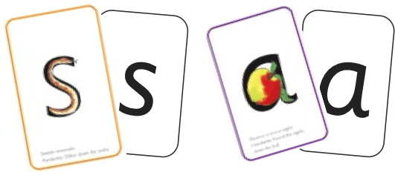
Sounds + blending = reading
+
Alongside teaching children sounds, we teach them to blend sounds to read words e.g. s-a-t, sat.
We use Fred Talk to help children read.
Notes:
Alongside teaching children sounds, we teach them to blend sounds to read words e.g. s-a-t, sat.
We use Fred Talk to help children read.

Slide 10
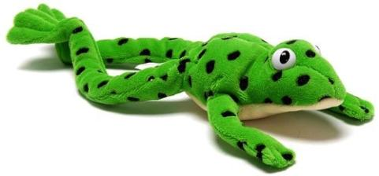
Fred
Let me introduce you to Fred.
Fred can only speak in sounds. He says d-o-g, h-a-t etc.
Speaking like Fred helps children to understand that words are made up of sounds.
Fred helps children practise blending sounds together because he needs the children to say the words for him. Fred says d-o-g, children tell him the word is dog.
This is how we quickly teach all of our children to blend.
Notes:
Let me introduce you to Fred.
Fred can only speak in sounds. He says d-o-g, h-a-t etc.
Speaking like Fred helps children to understand that words are made up of sounds.
Fred helps children practise blending sounds together because he needs the children to say the words for him. Fred says d-o-g, children tell him the word is dog.
This is how we quickly teach all of our children to blend.

Slide 11

Teach spelling using Fred Fingers
We use Fred Fingers to help children sound out words to spell easily.
It means they do not have to memorise lists of spelling words.
It is a tool so they will be able to spell any word.
Notes:
We use Fred Fingers to help children sound out words to spell easily.
It means they do not have to memorise lists of spelling words.
It is a tool so they will be able to spell any word.

Slide 12
‘Three with me, four at home’
In our school, children read each Read Write Inc. Storybook three times in class with their partner.
Re-reading the same book helps children to become confident readers. Each time they re-read, they build their fluency/speed and comprehension.
They love reading and want to read because they can read all of the words in the Storybook.
Then your child brings the same book home to read and enjoy with you again and again at home.
It’s ‘three with me, four at home.’
We do not send stories home the children cannot read because we always want them to be set up to succeed in their reading.
We want to make sure they enjoy reading so that they want to read.
The more they read, the faster progress they will make.
Notes:
In our school, children read each Read Write Inc. Storybook three times in class with their partner.
Re-reading the same book helps children to become confident readers. Each time they re-read, they build their fluency/speed and comprehension.
They love reading and want to read because they can read all of the words in the Storybook.
We set a focus for each re-read in school.
(Click) The first read focuses on reading every word accurately.
(Click) The second on reading the story more quickly.
(Click) The third read on comprehension - understanding what they read.
Then your child brings the same book home to read and enjoy with you again and again at home.
It’s ‘three with me, four at home.’
We do not send stories home the children cannot read because we always want them to be set up to succeed in their reading.
We want to make sure they enjoy reading so that they want to read.
The more they read, the faster progress they will make.

Slide 13
‘Three with me, four at home’
Accuracy The first read focuses on reading every word accurately.
Fluency The second on reading the story more quickly.
Comprehension The third read on comprehension - understanding what they read.
Read and enjoy at home!
Notes:
In our school, children read each Read Write Inc. Storybook three times in class with their partner.
Re-reading the same book helps children to become confident readers. Each time they re-read, they build their fluency/speed and comprehension.
They love reading and want to read because they can read all of the words in the Storybook.
We set a focus for each re-read in school.
(Click) The first read focuses on reading every word accurately.
(Click) The second on reading the story more quickly.
(Click) The third read on comprehension - understanding what they read.
Then your child brings the same book home to read and enjoy with you again and again at home.
It’s ‘three with me, four at home.’
We do not send stories home the children cannot read because we always want them to be set up to succeed in their reading.
We want to make sure they enjoy reading so that they want to read.
The more they read, the faster progress they will make.

Slide 14
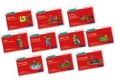
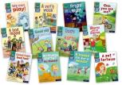

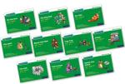
Which books will children bring home?
+
+
In your child’s book bag, they will bring home:
the Storybook they have read in class to practise reading what they can already read.
- A Book Bag Book. They have guidance inside just for you as parents., They are matched to the books children read in school so provide practice of the same sounds – extra practice at the right level for your child. They include many of the same reading activities that we use in class.
Notes:
In your child’s book bag, they will bring home:
the Storybook they have read in class to practise reading what they can already read.
if applicable a ‘Last and past’ Storybook – a previously read RWI Storybooks for extra practice. The children enjoy re-reading stories they know well. Their fluency improves on every reading.
- if applicable a Book Bag Book.They have guidance inside just for you as parents., They are matched to the books children read in school so provide practice of the same sounds – extra practice at the right level for your child. They include many of the same reading activities that we use in class.
A picture book to share with you which has already been read to them so they care about it. You can read the story to them or they can retell the story by looking at the pictures. They are not expected to read the story themselves.
We make sure that every book that goes into your child’s book bag is a well-loved book – one they know already and want to read again and again.

Slide 15
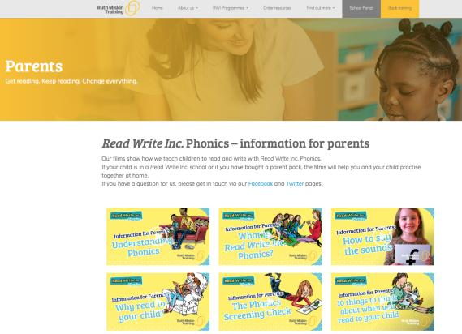
Free Video Tutorials (ruthmiskin.com)
Notes:
Watch video tutorials on the Ruth Miskin website to help you to understand more about Phonics, Read Write Inc. and how to practise reading and writing with your child at home.

Slide 16
What can I do?
Use pure sounds, not letter names
Use Fred Talk to read and spell words
Listen to your child read their Storybook every day
Read stories to your child every day
Notes:
We will run regular bitesize meetings to look at each of these in more detail.
Provide copies of ‘Reading at Home Booklet 1 or 2’ from Oxford Owl.
Booklet 1 is sound groups and Ditty/ Red Groups and Booklet 2 for Green – Grey Storybooks.

Slide 17
Online resources available
Ruth Miskin Parents’ Page:
http://www.ruthmiskin.com/en/parents/
Free e-books for home reading:
http://www.oxfordowl.co.uk/Reading/

