Slide 1
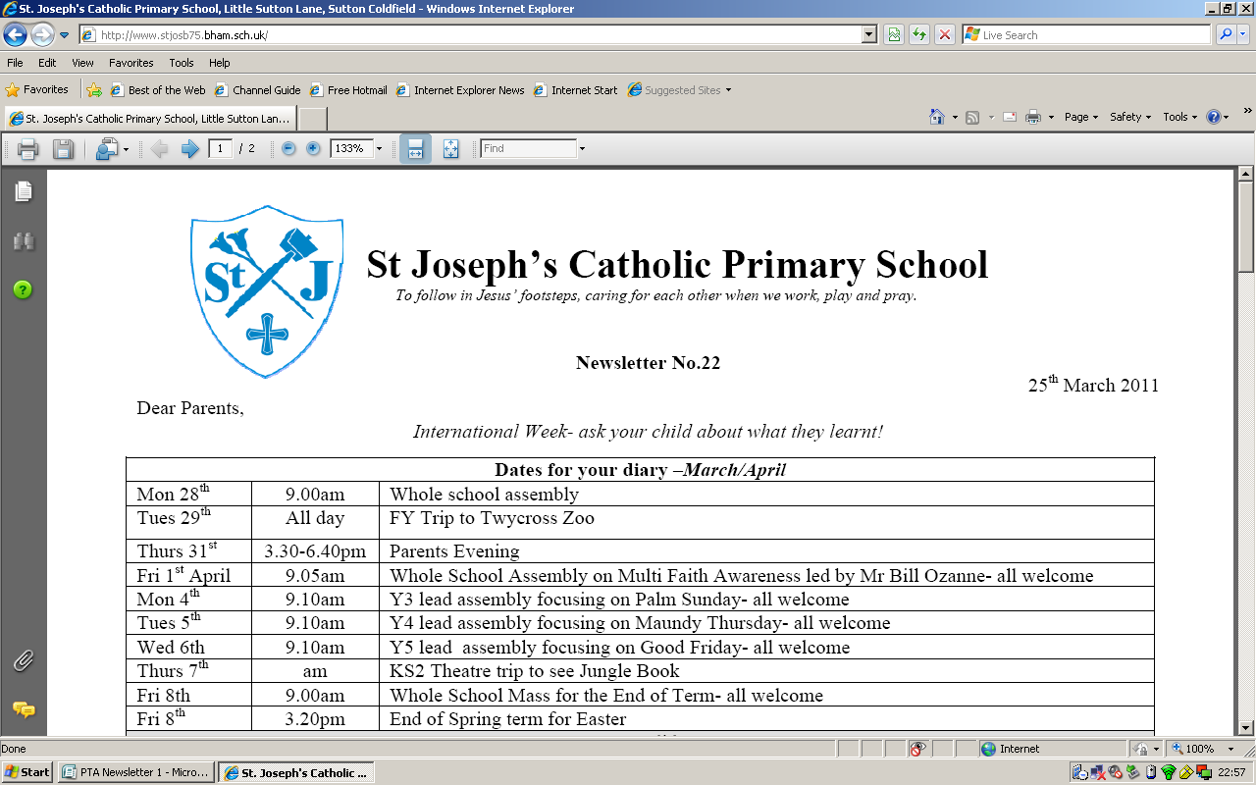
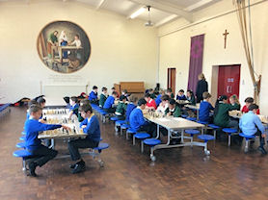
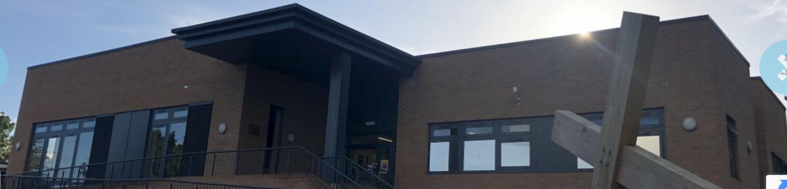
St Josephs RC Primary - PTA

Slide 2

Why Do we do this?
Simple – for our children
What is the PTA?
The PTA is a group of teachers and parents who meet to organise events and activities to raise funds for items the school would not normally be able to afford. Every parent becomes a member of the PTA when their child enters the school. Meetings are usually 1 per half term, and approximately an hour long.
What does the PTA do?
The PTA basically gets to do the fun stuff! The main events are the Christmas and Summer Fetes; school discos and parents social evenings. Earlier this year the PTA organised a very successful quiz night that was a great opportunity for parents to socialise whilst raising money for the school. The PTA always welcomes feedback and new ideas.
How can you help?
The one thing the PTA always needs is extra help, so anything you can do, no matter how big or small will be greatly appreciated.
If you are unable to attend the meetings but would like to offer some help or new ideas, then please speak to one of the PTA members.

Slide 3

PTA Events
School Christmas Fayre
School Summer Fayre
PTA Quiz Night
Kids Christmas/Summer Disco
Movie Night
Easter Egg Hunt
Sports Day Support

Slide 4
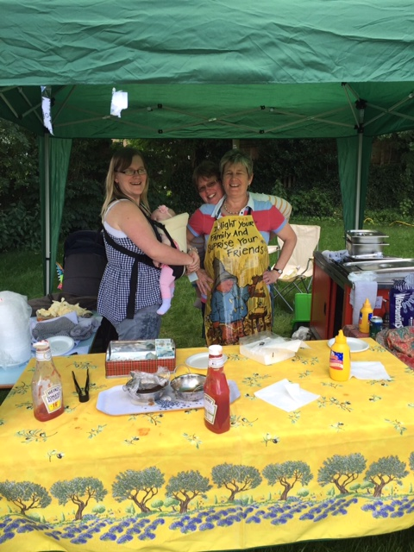
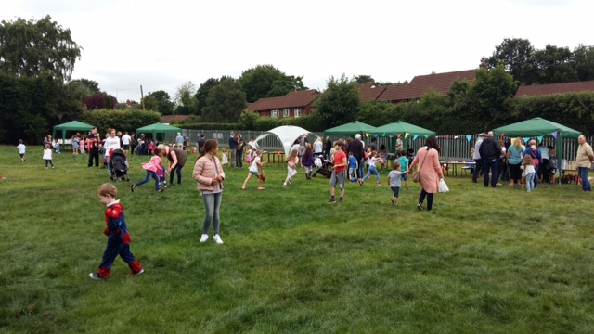
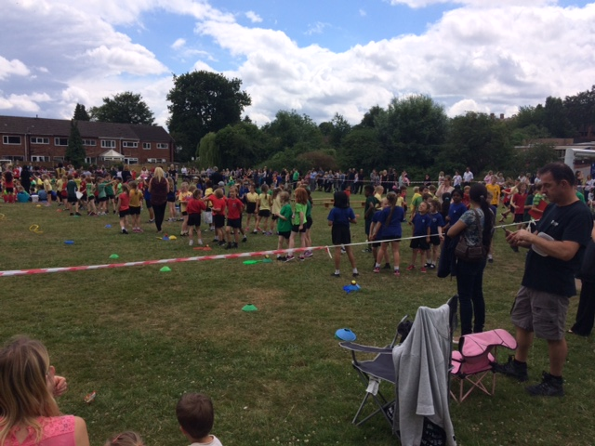
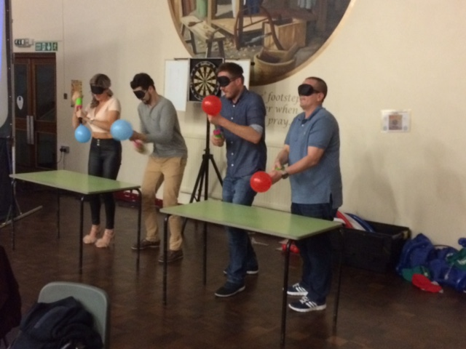
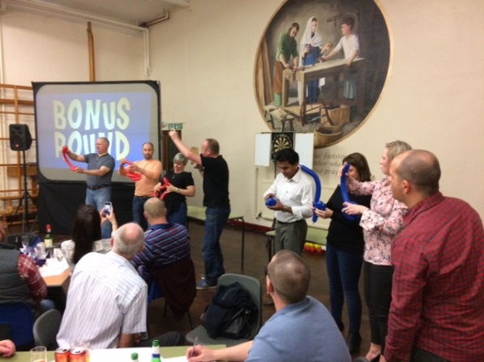
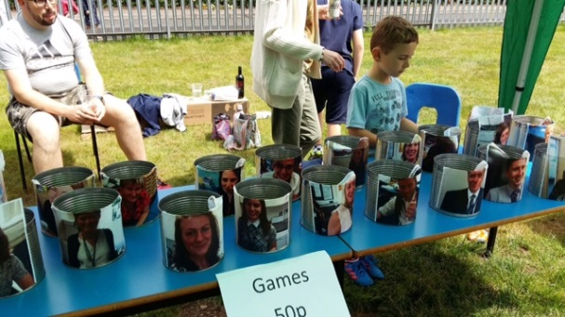
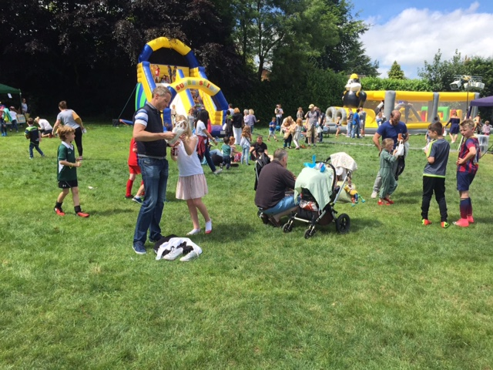
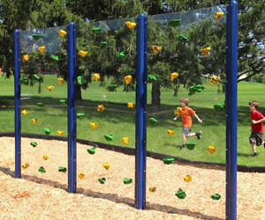
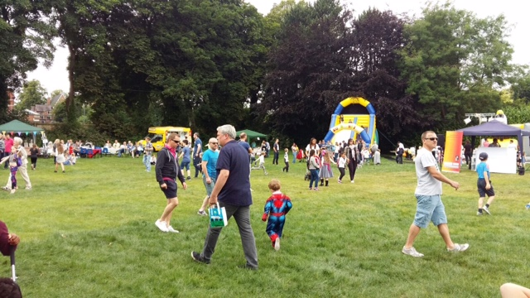
PTA Events

Slide 5

New Members
New Member are always welcome – please let us know your details and the Yr group your child belongs to and also if you are interested in any of the following positions –
Chairman
Vice Chairman
Secretary
Treasurer
Yr Rep

Slide 6

Account Update
Monies Raised –
Average year is between £6-8k
School Projects Supported
Hall PA System
Forest school landscaping
Climbing Wall

Slide 7

Future Plans
The PTA is an open forum for new ideas to support the children and the school,
Apart from the events above we are open to any new fund raising ideas, so please feel free to contribute in any way possible
PTA Committee
The PTA will need to have a new Chairperson, Vice Chair and Treasurer in place before the end of the academic year 21/22, if anyone would like to express an interest in these roles can they contact myself on vincetierney@blueyonder.co.uk

